Slide 1
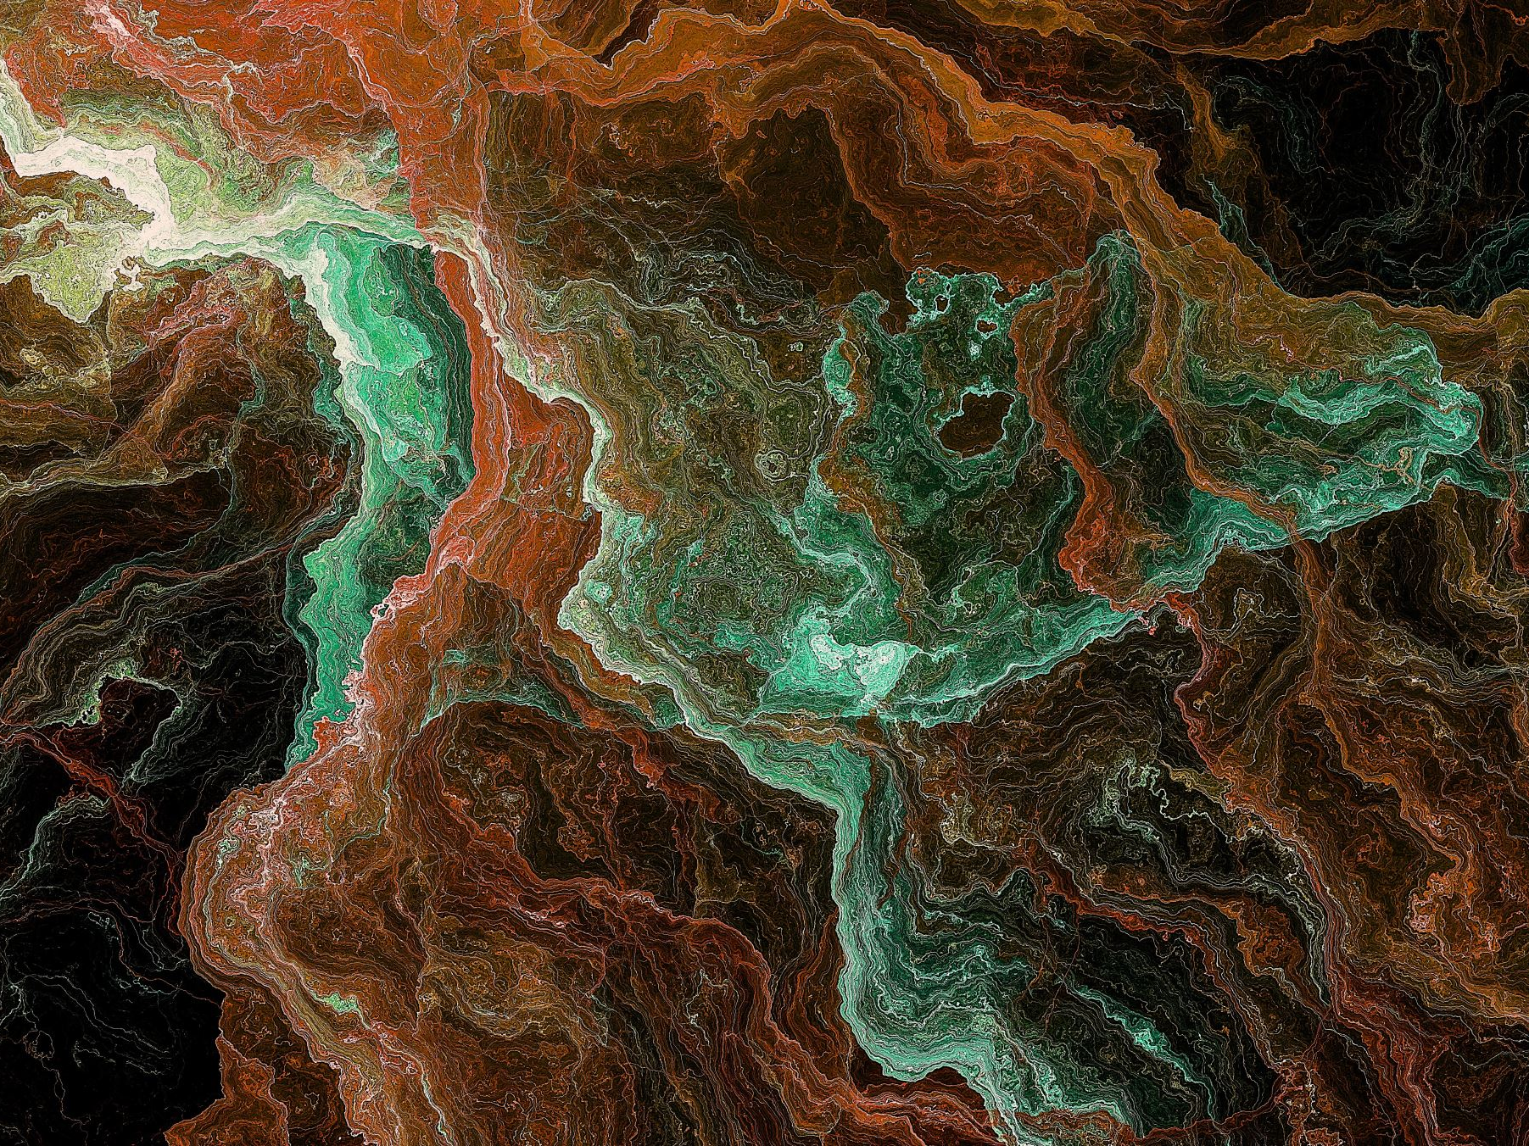
Literary Criticism (BA-TY)
Dr. Nirmala S. Padmavat
Director, IQAC
Nutan Mahavidyalaya, Selu

Slide 2
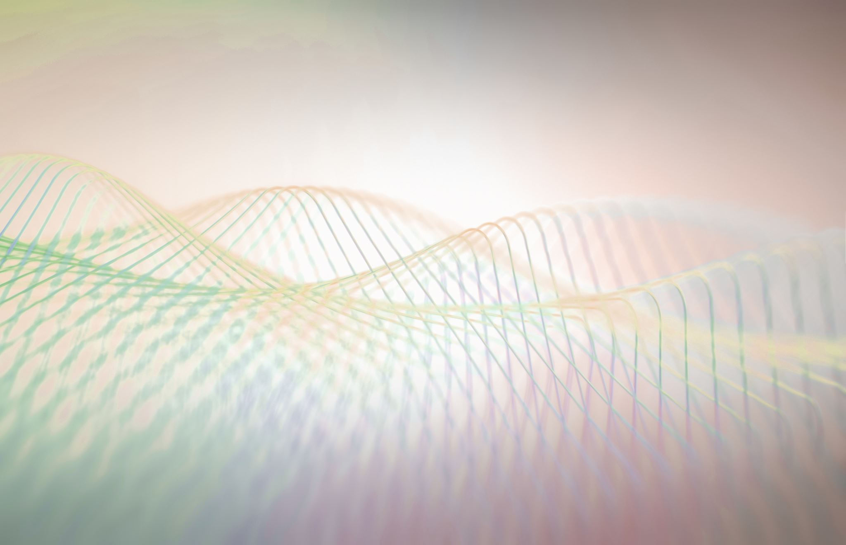
Aristotle’s Observation on Poetry (384-322 B.C.)

Slide 3
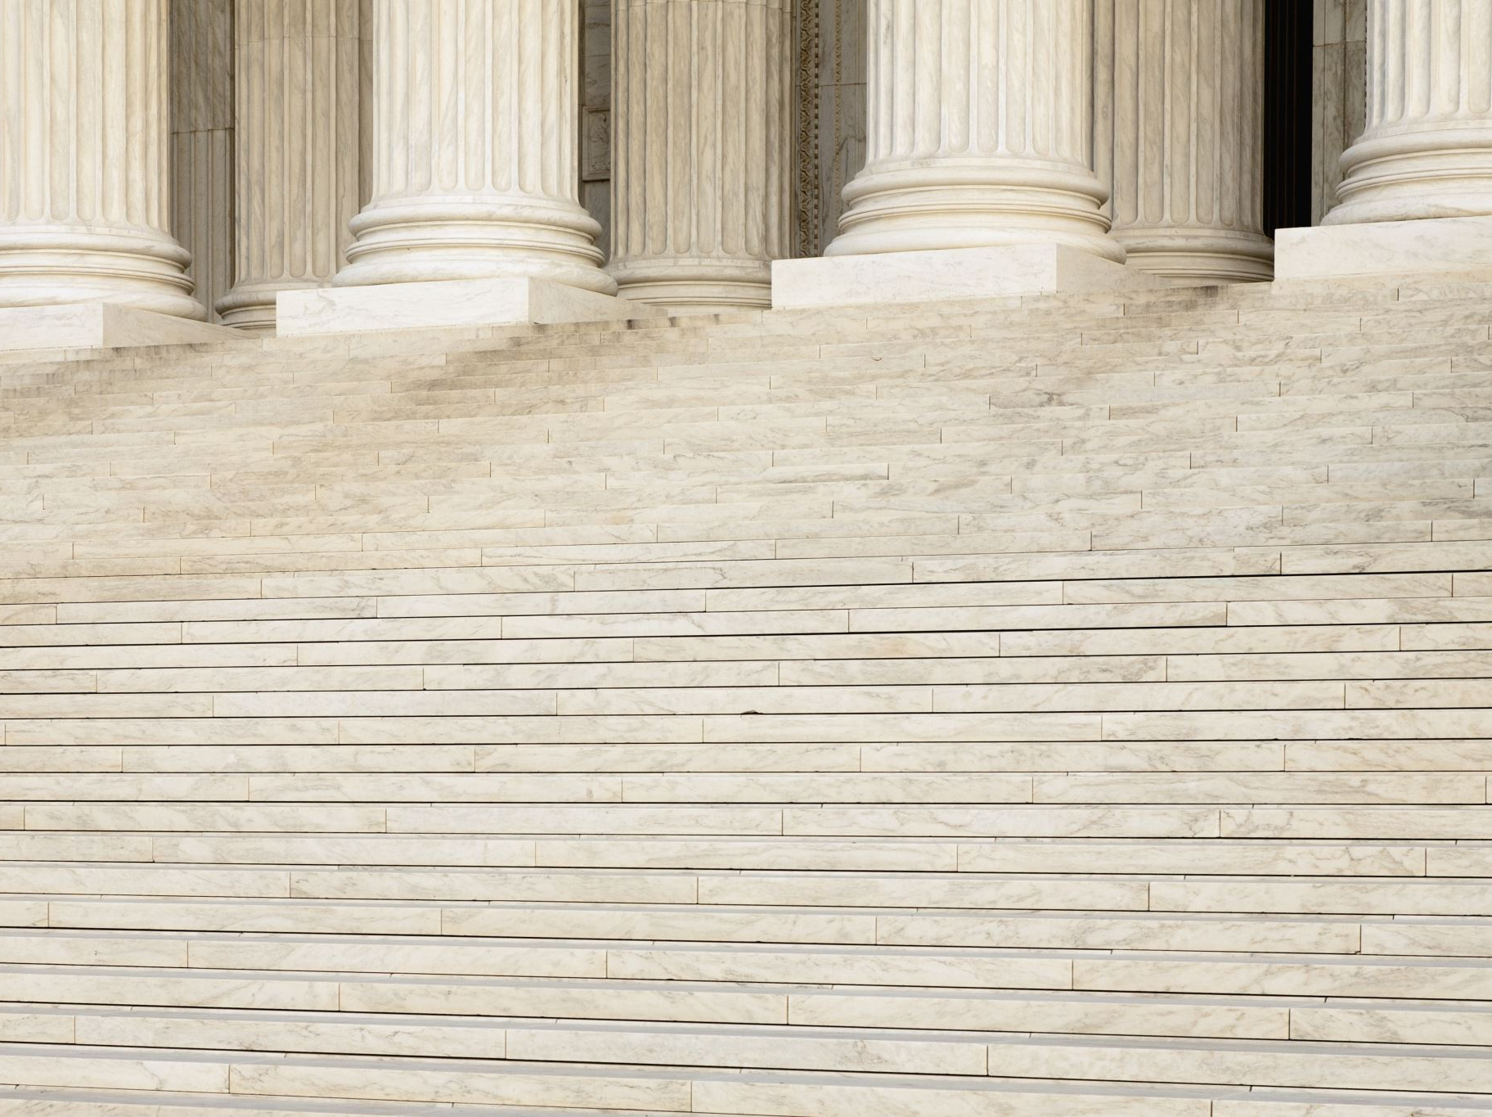
Life
Aristotle was a Greek philosopher. He is one of the greatest philosophers of all time. He was a pupil of the philosopher Plato. He studied under Plato in Athens for 20 years. Aristotle taught Alexander, the great, for six years. So, he is remembered as the tutor of Alexander, the great. He is often called the ‘Father of Logic’. Aristotle studied and wrote about every subject known to the Greeks. He wrote about physics, astronomy, politics, ethics, literature and aesthetics. He was one of the first writers of literary criticism.

Slide 4
Work
He had written nearly of a dozen critical treatises. Among them Poetics deals with art of poetry, and Rhetoric deals with art f speaking. The Poetics is a fragmentary incomplete work of literary criticism; it deals with tragedy, comedy and epic poetry. It can be called a reply to Plato’s criticism of poetry. Aristotle’s conclusions on the nature of poetry and drama are of general application.

Slide 5
Aristotle’s observations on ‘poetry’
The nature of poetry:
Poetry is the highest creative art according to Aristotle. Poetry tries to express the universal element in human nature and in life. Aristotle says that poetry deals with the universal while history deals with the particular. Poetry does not care so much for what has happened but it deals with what may happen, like Plato, Aristotle calls the poet an imitator. The poet imitates one of three objects- things as were or are, things as they are said or thought to be, or things as they ought to be.

Slide 6
Origin of Poetry
According to Aristotle poetry had its origin in four human instincts. They are-
a) The natural human instinct to imitate things, as we observe in the case of monkeys and children.
b) The natural pleasure we get from a good work of imitations. It is for this reason that accurate imitations of even ugly objects give pleasure.
c) Learning of knowing something new a always a pleasure. It is for this reason we derive pleasure form an imitation of an object. We have never seen before.
d) Poetry grew out of these natural causes. It got its nature through these causes.

Slide 7
Function of Poetry
Aristotle says the pleasure is the end of poetry. Like other fine arts, to please is the function of poetry. The important two human instincts i.e. of imitation and of harmony and rhythm are the origin of poetry. These two very reasons give pleasure to the poet and the reader also. In addition to it, Aristotle accepts teaching as the function of poetry. But it should not be the main function of poetry. To him, ‘Pleasure’ along with ‘truth’ is superior to all others, because, along – with pleasure it improves civic morality.

Slide 8
Poetry and its Emotional Appeal
Aristotle admits Plato’s opinion that poetry makes an immediate appeal to the emotions. He says, tragedy is the highest form of poetry. His greatness lies in his finding out the real greatness and beauty of tragedy. In his theory of ‘Katharis’ (Catharsis), he answers the charges of Plato against tragedy and also tells us why we rush to see or read a tragedy and why we always take it to better than a comedy. Plato says that art corrupts by appealing not to the reason, but to the emotions. It excites and nourishes the passions. So, poetry is baneful to the healthy growth of the mind. On the contrary, Aristotle has not such fear. Aristotle feels tragedy, gives new knowledge and aesthetic satisfaction, and produces a better state of mind. He adds, everybody has occasions of fear and pity in life. When we witness such occasions in tragedy or any other kind of poetry, we become nobler than before. So, the emotional appeal of poetry is not harmful but, health – giving and artistically satisfying.

Slide 9
Conclusion
Aristotle, in his observation on poetry, rejected Plato’s whole theory that the emotions are themselves bad. Particularly, he refuted Plato’s opinion that poetry produces a dangerous excess of these emotions in real life. Thus, Aristotle defends poetry from Plato’s attack on it.

Slide 10
Thank you!

